Slide 1
University Networking Project using Packet Tracer
Introduction to University Network Design using Packet Tracer
Teem:
Abdelrahman Khaled
Abdulrahman Zakaria
Ahmed Mohammed Omar
Sara Mostafa Ahmed Helal
Mohammed Reda
Sara Ali Ghaly

Slide 2

© ALASMAR TECH 2024

Slide 3
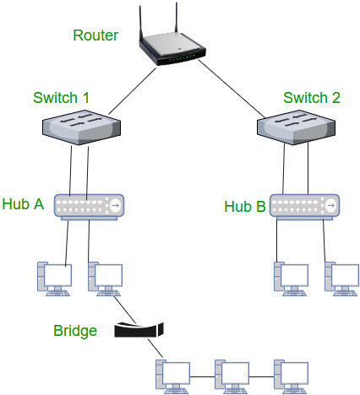
Introduction
project aims to design and implement a robust, efficient, and scalable network infrastructure tailored to meet the growing needs of a university. This network will provide seamless connectivity for students, faculty, and staff, supporting academic, research, and administrative functions. By ensuring reliable access to digital resources, communication tools, and online services, the project will enhance collaboration, learning, and overall productivity within the university. Additionally, the network will be designed with scalability in mind, accommodating future technological advancements and expansion.
© ALASMAR TECH 2024

Slide 4
Abstract
The "Established Network for University" project aims to create a secure and efficient network infrastructure that meets the technological needs of a university. This project focuses on providing high-speed internet access, seamless connectivity, and secure communication channels for students, faculty, and administrative staff. The network will support academic activities, online learning, research, and administrative operations, ensuring reliable performance and data security. Designed with scalability, it will accommodate future growth and technological advancements, making it adaptable to the university's evolving requirements.

Slide 5
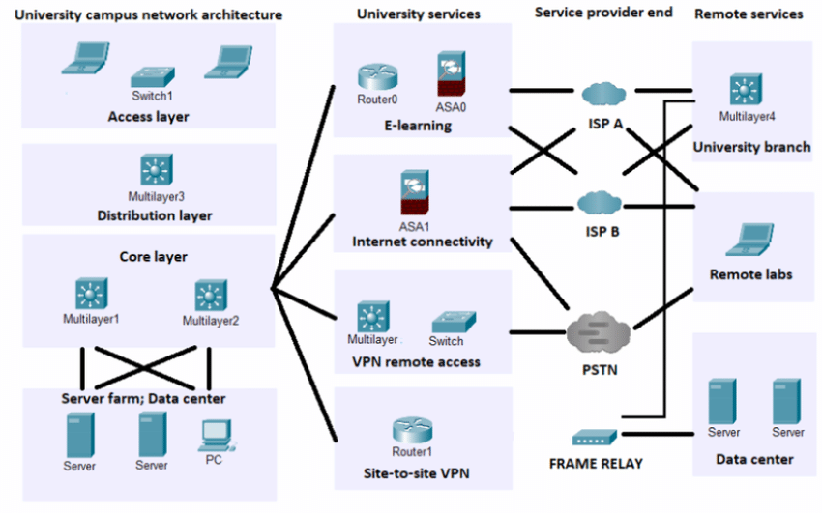
Importance of Networks in Educational Institutions
Facilitate access to shared resources.
Enhance communication and collaboration between students and staff.
Increase security by controlling access to sensitive data.
Save time and effort by automating information exchange processes.
© ALASMAR TECH 2024

Slide 6

Project Concept
Design an integrated university network using Packet Tracer.
1
Divide the university into dedicated VLANs for specific departments.
2
Ensure data security and define access permissions between different departments.
3
© ALASMAR TECH 2024

Slide 7

Methodology
1. Network Fundamentals
IPv4 addressing and subnetting
Ethernet, MAC addressing, and basic Layer 2 concepts
2. LAN Switching Technologies
VLANs (Virtual Local Area Networks)
Inter-VLAN Routing
Switching Concepts (frame forwarding, MAC address table)
STP (Spanning Tree Protocol) and variants (RSTP)
EtherChannel (link aggregation)

Slide 8

Methodology
3. Routing Technologies
EIGRP (Enhanced Interior Gateway Routing Protocol)
4. WAN Technologies
NAT (Network Address Translation) - Pat
5. Security Fundamentals
Device Security: passwords, user authentication
Access Control Lists (ACLs): standard and extended
Port Security on switches

Slide 9

Methodology
6. IP Services
DHCP (Dynamic Host Configuration Protocol)
DNS (Domain Name System)
Syslog for logging device events
NTP (Network Time Protocol) for clock synchronization
7. Infrastructure Management
TFTP/FTP for backup of configuration files
8. Wireless Networking
Wireless LAN concepts
Wireless access points and controllers
© ALASMAR TEC 2024

Slide 10
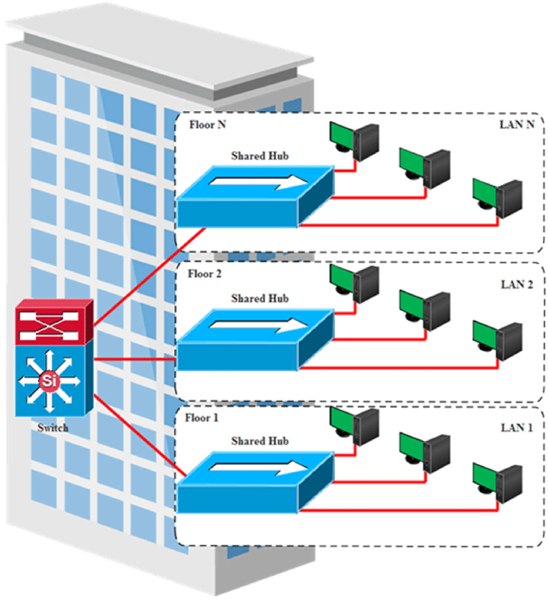
VLAN Division
VLAN 10: Designated for the Admin Department.
VLAN 20-40: Designated for finance , hr and business.
VLAN 50-80: Designated for Student Labs , colleges ,student labs and IT.
Use ACLs to ensure data security and prevent unauthorized access.
VLAN 90-100 : branch compus for student labs and staff
© ALASMAR TECH 2024

Slide 11
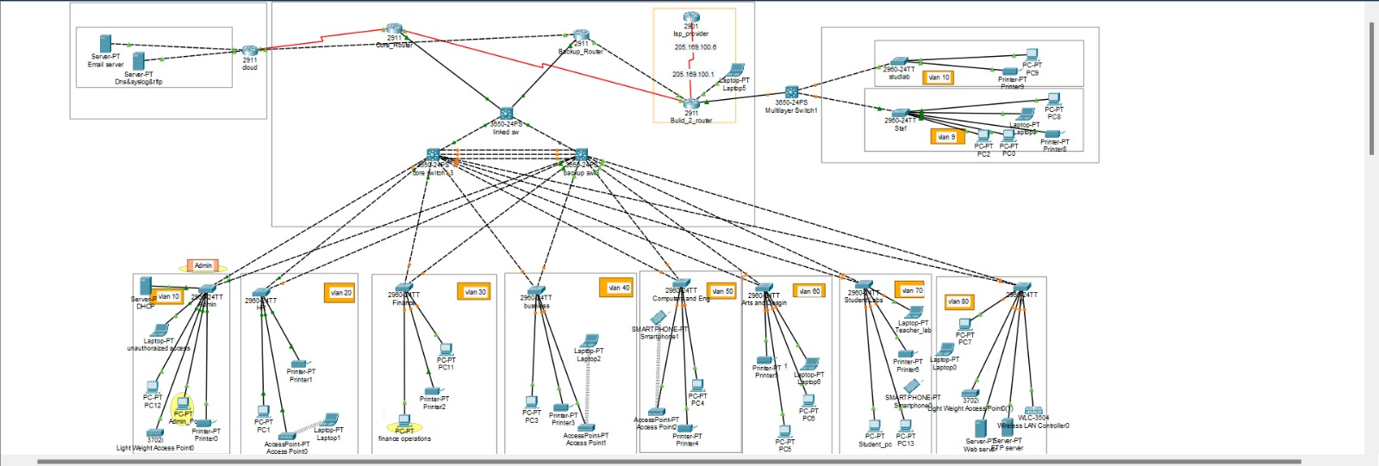
Final Network Diagram
© ALASMAR TECH 2024

Slide 12
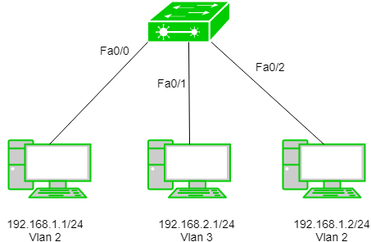
Project Summary
An integrated network was implemented for the university using Packet Tracer.
The network was divided into VLANs to ensure data security and access control.
Security protocols such as SSH were activated to protect the network from breaches.
© ALASMAR TECH 2024

Slide 13
conclusion
In conclusion, the "Established Network for University" project successfully delivers a robust and secure network infrastructure tailored to the university’s diverse needs. By providing fast, reliable, and secure connectivity, the network enhances the academic and administrative experience, enabling efficient communication, online learning, and research activities. The scalable design ensures that the network can adapt to future technological developments and growing demands, laying a strong foundation for the university’s continued success in an increasingly.

